Slide 1
C# and Visual Studio
An introduction

Slide 2
Need Help?
Ask Us
IntelliSense (Autocomplete tool in Visual Studio)
https://msdn.microsoft.com

Slide 3
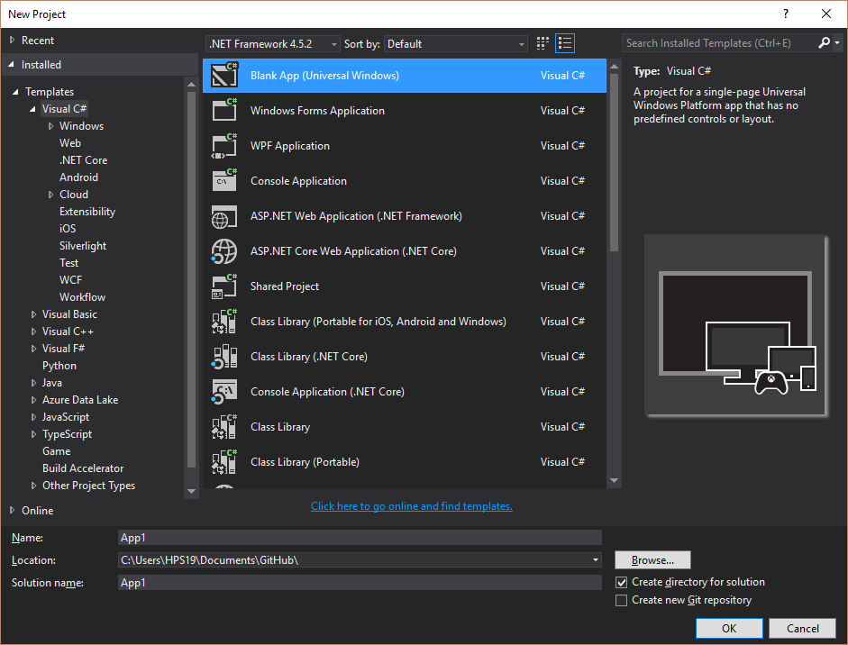
Project Types

Slide 4
Windows Form Applications
They’re not pretty, but they do the job
Great prototyping tool

Slide 5
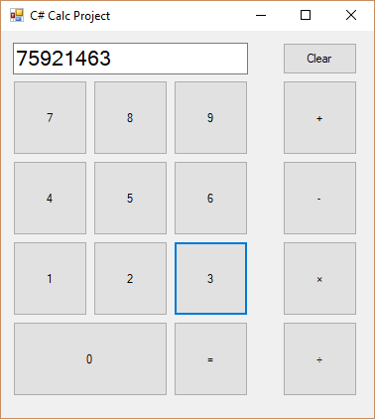
What we’ll have by the end

Slide 6
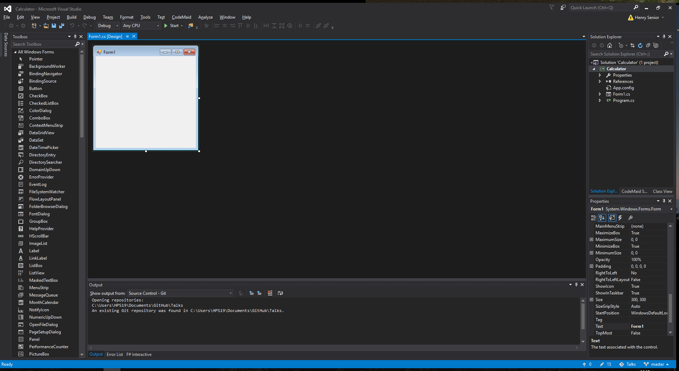

Slide 7
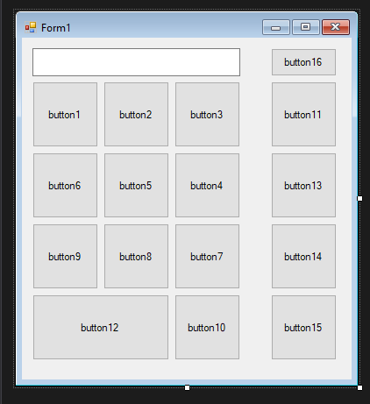
Making the UI

Slide 8
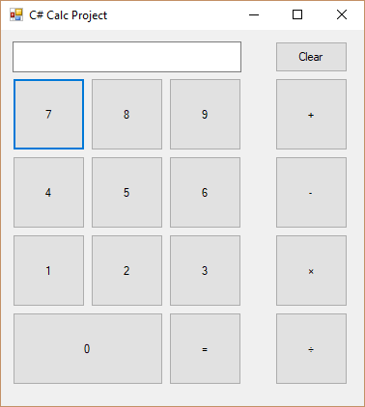
Making it look like a calculator
Naming the Items:
Select the Form Item -> (Name) option in the “properties” tab
Give it an appropriate name
Eg) text box for the answers should be txtBoxAnswer
Setting the values:
Select the Form Item -> Text
Give it an appropriate value

Slide 9
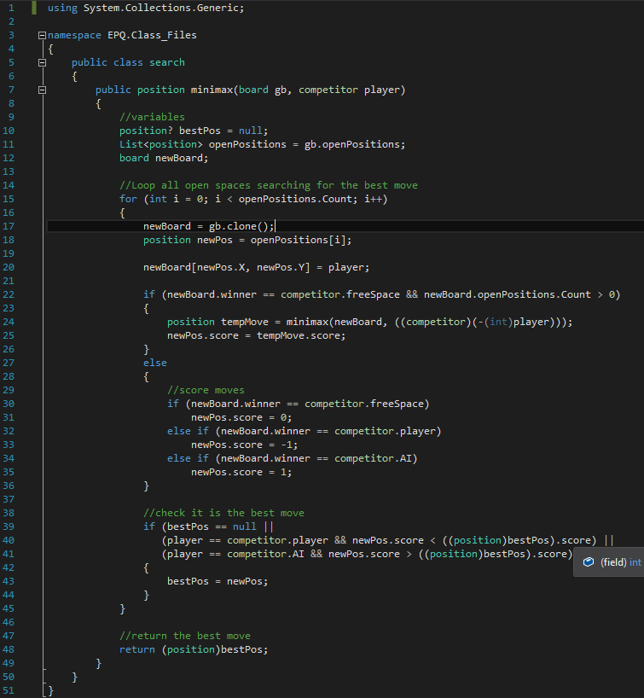
Some theory: Basic structure
Imports
Namespace
Class
Global variables
Methods
Local variables
Code that actually does stuff

Slide 10
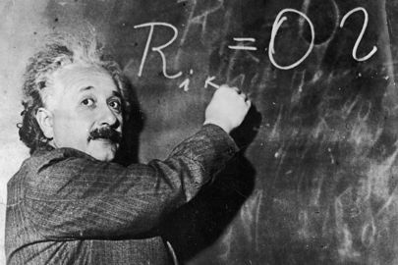


Time for some theory: variables
A box
With a type
And a name

Slide 11
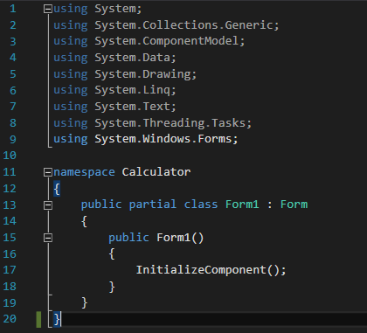
Making some variables
View -> Code (or press F7)
Between public partial class Form1 : Form and
public Form1() we want:
Double for the 1st input
Double for the 2nd input
Double for the answer
String for the operation
They don’t need a value

Slide 12
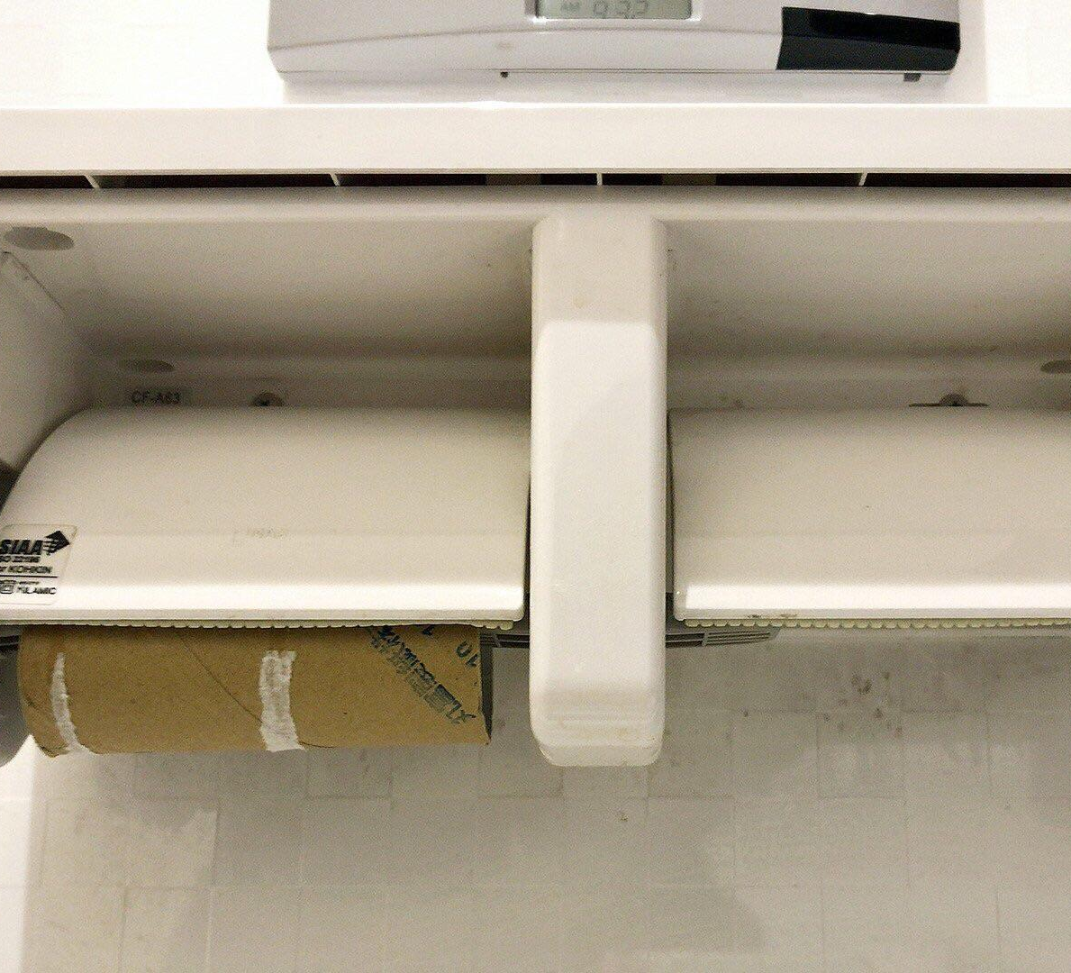
Time for some theory: A note on “null”
double inp1;
Inp1 has a value assigned by the interpreter
It’s a special value known as “null”
Null IS NOT THE SAME AS 0 OR “”

Slide 13
Let’s get the buttons doing something
Property
Object
Value
Double click on the number button 0
This will create and event method
Which will run when the button is pressed
When a number button is pressed we want the number to appear in the text box
Repeat this for button 1 then run your project and input the number 10
<text box name>.Text = "0";
Terminator

Slide 14
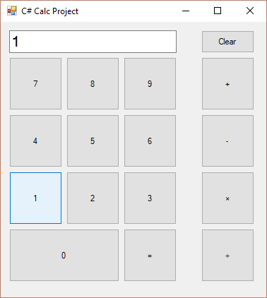
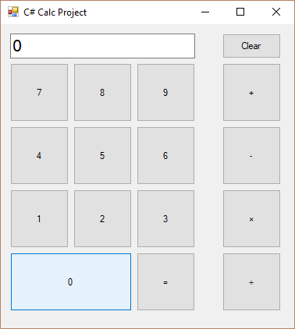
Bug

Slide 15
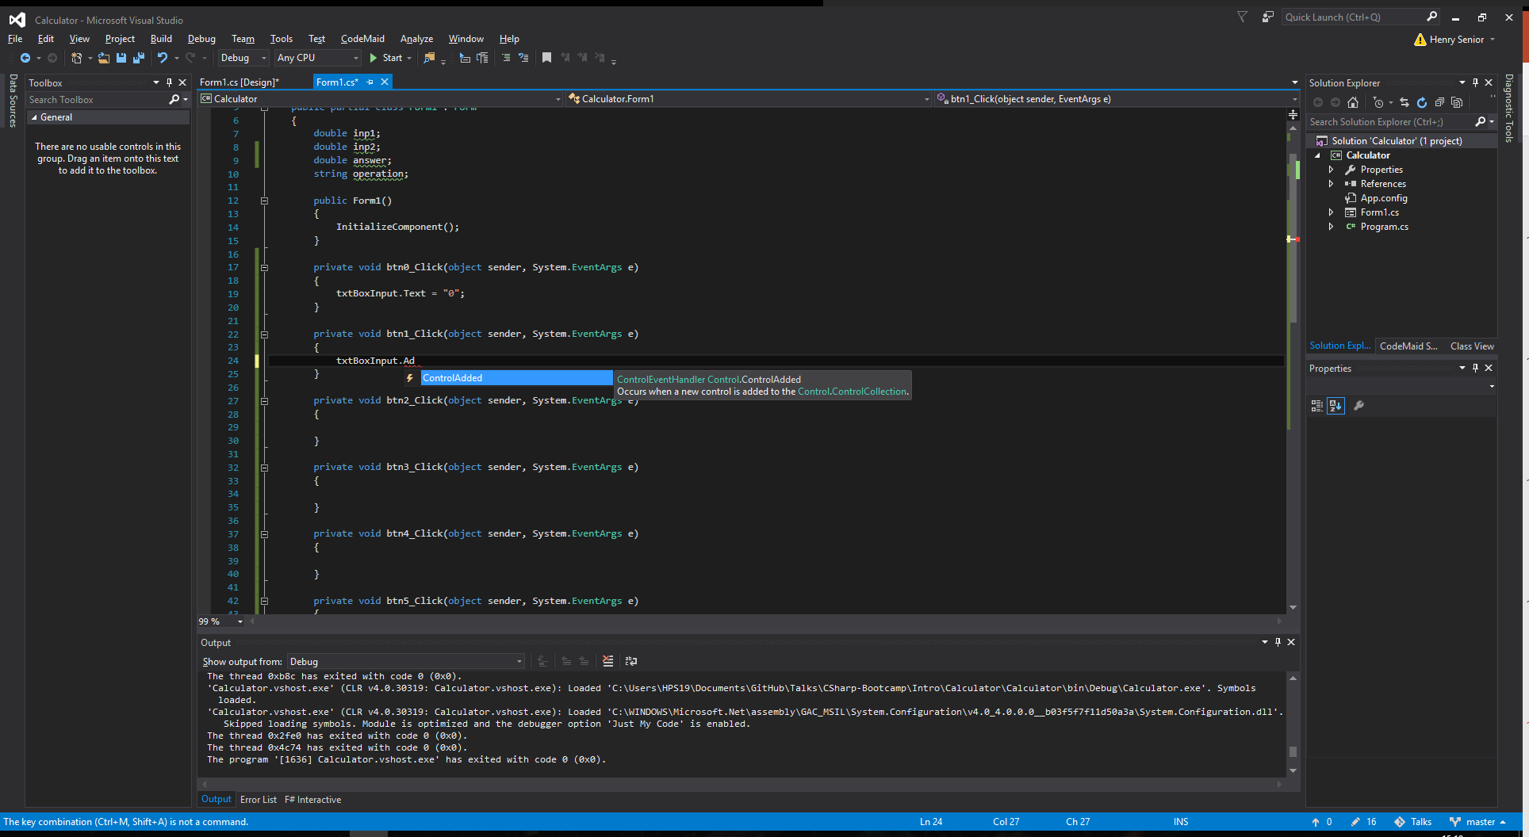
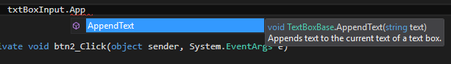
What’s Going on Here?
Our code gives the property “Text” the value of either “0” or “1”
This isn’t actually what we want to do
We want to add “0” or “1” to the text property
Use IntelliSense to find the property we need:
Add isn’t a property…
What’s another word for add?
Lets try append
Hey presto!
Now we know AppendText is the method we need to use

Slide 16
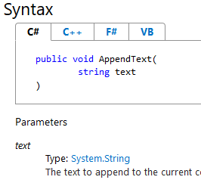
Time for some theory: Properties and Methods
A property is a variable we can access (sometimes known as fields)
A method is a collection of code that does something
They can return values
Change properties
Sometimes they take values
AppendText() will take a string as shown in the documentation

Slide 17
Lets get those buttons working
Create methods for the rest of the number buttons
Use <text box name>.Text to enter the correct number into the text box

Slide 18
Addition
Create a button pressed event for the addition button
This method should:
Store the inputted number in a variable
Set the operation to “add”
Clear the text box
private void btnAdd_Click(object sender, System.EventArgs e)
{
inp1 = System.Convert.ToDouble(txtBoxInput.Text);
operation = "add";
txtBoxInput = "";
}

Slide 19
Other Operations
They’re going to look very similar
Repeated code is bad
Lets make a method to store the number and set the operator

Slide 20
Time for some theory: Methods
A Collection of Code
With an access type
A name
And possibly some parameters
Access type can be private or public
Name should be meaningful and represent what it does
Parameters are variables declared in a method

Slide 21
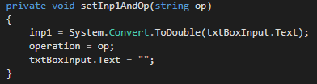

Making our method and using it

Slide 22
Getting more input
Make a button click event for the equals button
Set answer equal to the return value of calculateOutput() [we’ll write this shortly so expect an error]
Set the text box text to answer
Have a go! Answer on the next slide

Slide 23
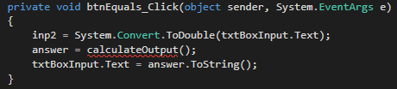

Slide 24
Time for some theory: Flow control
Do something based on a condition
My wife said: "Please go to the store and buy a carton of milk and if they have eggs, get six." I came back with 6 cartons of milk She said, "why in the hell did you buy six cartons of milk?“ "They had eggs“ I replied
IF (hasEggs == true)
buy 6 cartons of milks
ELSE
buy 1 carton of milk
END IF

Slide 25



private double calculateOutput()
Check the value of operation
Do different things based on it’s value

Slide 26
Time for some theory: Loops
Used to repeat lines of code a certain amount of times
Print 1 – 10
Echo 1
Echo 2
Etc
For int i = 0 To 10
echo I
loop

Slide 27
Using a For Loop for multiplication
Syntax
for(int i = 1; i <= inp2; i++)
{
//loop code
}
returnAns = returnAns + inp1;
Loop counter creation
Loop condition
Counter operation
Type of loop

Slide 28
Multiplication the easy way
returnAns = inp1 * inp2;

Slide 29
Lets Test It
It chains calculations together
When we enter the first number we want to check if a calculation has just been completed
If it has, we want to reset the data

Slide 30
Fixing the Final Bug
Introduce a new global variable isComplete
Write a clear data method, that takes no parameter and has no return value
This should:
Set input 1, input 2, and answer all equal to 0
Set the operation to null
Clear the text in the text box
Set isComplete to false
Remember to set isComplete to true in the equals button event
Answer on the next slide

Slide 31
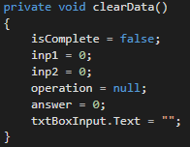

Slide 32
Calling clearData()
Before calculateOutput() returns its value, set isComplete to true
When a number is pressed
Check if isComplete = true
If it does, run clearData()
Regardless of isComplete’s value, the number selection code should run
Noticing a lot of repetition in your code? Lets make another method!

Slide 33
selectNumber method
A private method
With no return value
Takes a parameter of the number selected
Check if isComplete = true
If it is run clearData()
Regardless of isComplete’s value, the number selection code should run
Answer on next slide

Slide 34
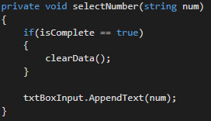

Slide 35
All done!
Any questions?

